Slide 1
Neural Network
Instructor: Dr. Yan Yan

Slide 2
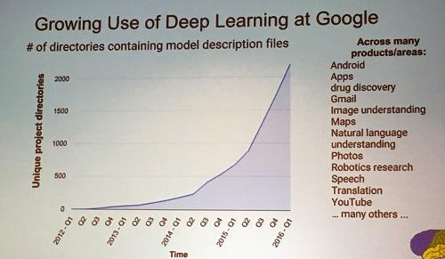
Deep learning attracts lots of attention.
I believe you have seen lots of exciting results before.
Deep learning trends at Google. Source: SIGMOD 2016/Jeff Dean
Deep learning trends at Google. Source: SIGMOD 2016/Jeff Dean

Slide 3
Ups and downs of Deep Learning
1958: Perceptron (linear model)
1969: Perceptron has limitation
1980s: Multi-layer perceptron
Do not have significant difference from DNN today
1986: Backpropagation
Usually more than 3 hidden layers is not helpful
1989: 1 hidden layer is “good enough”, why deep?
2006: RBM initialization
2009: GPU
2011: Start to be popular in speech recognition
2012: win ILSVRC image competition
2015.2: Image recognition surpassing human-level performance
2016.3: Alpha GO beats Lee Sedol
2016.10: Speech recognition system as good as humans

Slide 4
Deep learning Giant

Slide 5
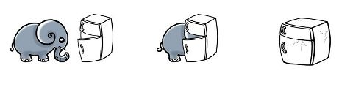
Three Steps for Deep Learning
Step 1:
define a set of function
Step 2:
goodness of function
Step 3:
pick the best function
Deep Learning is so simple ……
Neural
Network

Slide 6
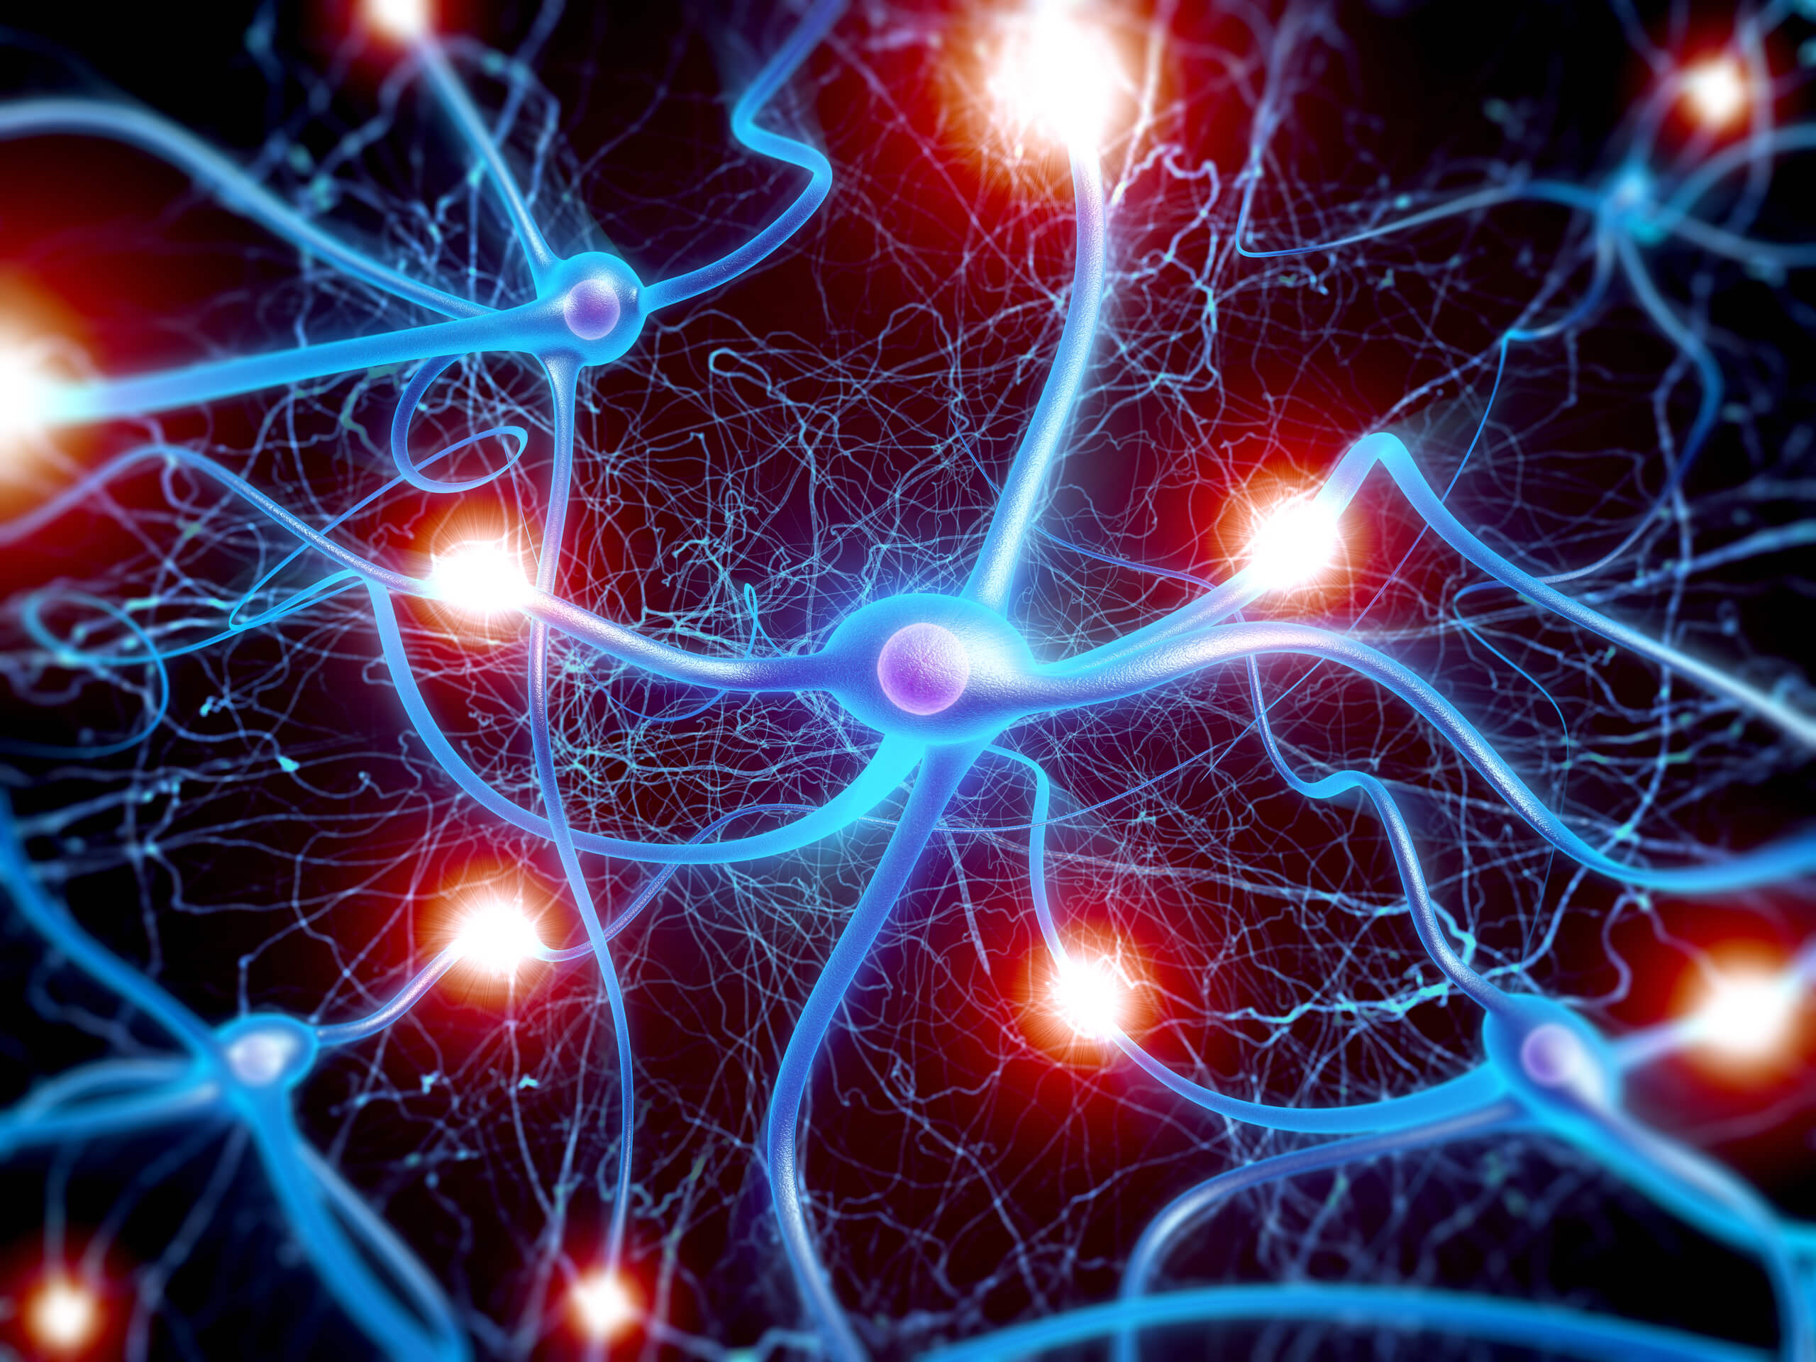
Neural Network
“Neuron”
Different connection leads to different network structures
Network parameter $θ$: all the weights and biases in the “neurons”

Slide 7
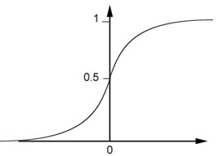
Fully Connect Feedforward Network
1
4
0.98
1
-2
1
-1
-2
0.12
-1
1
0
Sigmoid Function
Notes:
到这一页

Slide 8
Fully Connect Feedforward Network
1
4
0.98
2
0.86
3
0.62
1
-2
-1
-1
1
0
-2
-1
-2
0.12
-2
0.11
-1
0.83
-1
1
-1
4
0
0
2

Slide 9


Fully Connect Feedforward Network
1
0.73
2
0.72
3
0.51
0
-2
-1
-1
1
0
-2
-1
0.5
-2
0.12
-1
0.85
0
1
-1
4
0
0
2
This is a function.
$$f\left(\left[\begin{matrix}1 \\ −1\end{matrix}\right]\right)=\left[\begin{matrix}0.62 \\ 0.83\end{matrix}\right]$$
$$f\left(\left[\begin{matrix}0 \\ 0\end{matrix}\right]\right)=\left[\begin{matrix}0.51 \\ 0.85\end{matrix}\right]$$
Input vector, output vector
Given network structure, define a function set

Slide 10
Fully Connect Feedforward Network
neuron
Input
Layer 1
Layer 2
Layer L
Output
…
y₁
…
y₂
…
…
…
…
…
…
y_{M}
Input Layer
Output Layer
Hidden Layers

